Slide 1

ShivX – Your Infra, Your Cloud Major Project (23ONMCR-753) Master of Computer Applications – Fourth Semester Batch: July 2023 – Session 2023–2025
Prepared by: Shivam Upadhyay University ID: O23MCA110222
Centre for Distance & Online Education Chandigarh University

Slide 2
Objectives of the Major Project
Develop Practical Skills: Gain hands-on experience in software testing by applying industry-standard tools and techniques to solve real-world problems.
Bridge Theory and Practice: Integrate concepts learned in previous semesters with practical project work, enhancing both technical and analytical abilities.
Comprehensive Documentation: Prepare complete project documentation, including Software Requirements Specification (SRS), modeling, development, and implementation strategies.
Industry Relevance: Focus on solutions applicable to current challenges in computer science, IT, and software engineering domains.
Independent Project Execution: Undertake the project individually, demonstrating initiative, problem-solving skills, and project management capabilities.

Slide 3
Hardware & Software Requirements
Hardware Requirements
Pentium-IV processor or above
Minimum 2GB RAM
40GB Hard Disk
Graphics card (recommended)
Additional interfaces as needed
Software Requirements
Front-end Tools: (Specify the IDE or software used for designing the user interface, e.g., Visual Studio Code, Eclipse)
Back-end/Database: (Mention the database or storage solution, e.g., MySQL, MongoDB)
Programming Language: (State the main coding language, e.g., Python, Java, C#)
Internet Technologies: TCP/IP, FTP, Telnet, SMTP, Java, RMI, CORBA, Swing, JSP, Servlets
Operating Systems: Windows 10/8/7/XP/Vista, UNIX, Linux, Android
These requirements ensure the project is developed using up-to-date technology and is compatible with current industry standards.

Slide 4
Broad Areas of Applications
Mobile Application Development: Testing mobile apps for functionality, usability, and performance across various platforms and devices.
Machine Learning: Validating data-driven models and algorithms to ensure accuracy, reliability, and scalability.
Software Engineering: Applying structured testing methodologies to enhance software quality and maintainability in diverse engineering projects.
Database Management Systems: Design, development, and testing of robust systems to store, retrieve, and manage data efficiently.
Computer Communication & Networking: Ensuring the reliability and security of data transmission across networks through comprehensive software testing.
These broad areas reflect the dynamic and interdisciplinary scope of software testing in today’s technology-driven world.

Slide 5
Major Project Guidelines
To ensure academic integrity and quality, each student must complete the major project individually. Duplicate reports are strictly not accepted. You are required to submit a comprehensive soft copy of your project, including source code, executable files, detailed documentation, and your presentation. Evaluation will be conducted by both internal and external examiners, and you must demonstrate your project on the university-specified date. Timely submission is mandatory for successful completion.

Slide 6
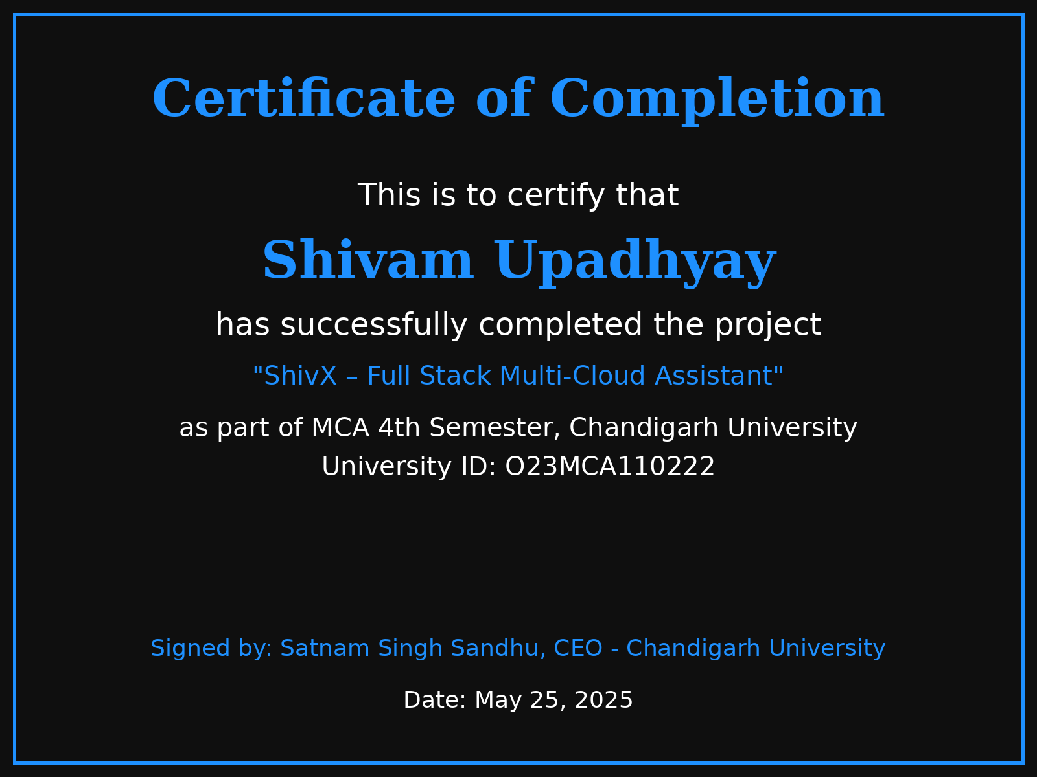

Slide 7
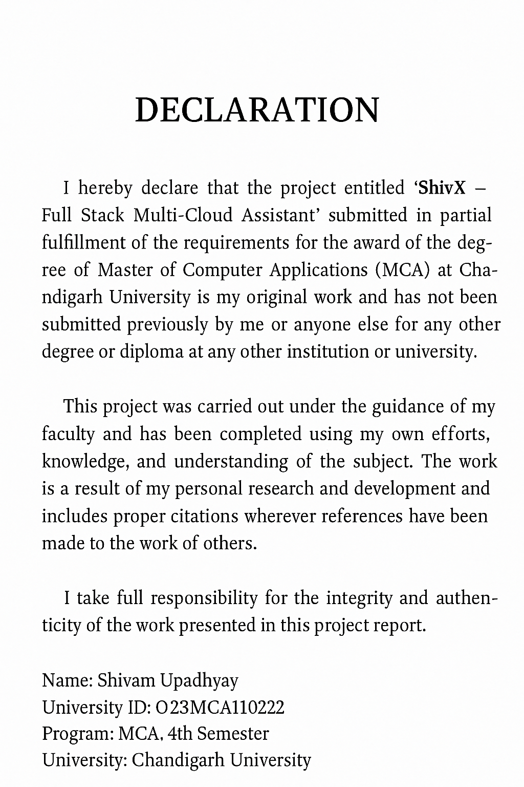

Slide 8
🌟 Acknowledgement
I am sincerely grateful to Chandigarh University for providing the opportunity and academic environment to work on my final semester project titled “ShivX – A Full-Stack Multi-Cloud Integrated Web Application”.
I extend my heartfelt thanks to my faculty mentors and academic guides whose continuous support, constructive feedback, and technical guidance were instrumental in shaping this project. Their expertise and encouragement helped me navigate challenges and bring this idea to life.
My sincere appreciation also goes to my peers and colleagues for their collaboration and moral support throughout the development process.
A special note of thanks to my family for their unwavering belief in me, and for being a constant source of motivation during this journey.
This project not only enriched my technical skills but also deepened my understanding of real-world cloud-based application development.
Shivam Upadhyay
University ID: O23MCA110222

Slide 9
Abstract
ShivX is an advanced AI-powered cloud infrastructure management platform designed to automate and streamline the administration of servers, security protocols, networks, and workstations within a unified application. By integrating state-of-the-art artificial intelligence, ShivX transforms the traditional approach to cloud infrastructure management, enabling clients to effortlessly handle complex deployment and configuration tasks. This automation significantly improves operational efficiency by reducing manual intervention and minimizing human errors. Additionally, ShivX enhances the security posture of cloud environments through intelligent monitoring and adaptive threat responses. With built-in redundancy and scalability, ShivX ensures continuous availability and resilience across multi-cloud ecosystems. Overall, ShivX empowers organizations to manage their cloud resources more effectively, securely, and reliably, driving innovation and business continuity.

Slide 10
Table of Contents
Introduction
AI-powered automation platform for cloud infrastructure management
Simplifies resource control via voice commands and intelligent workflows
Problem Statement
Complex cloud environments require constant manual oversight
Traditional tools are inefficient and require specialized skills
Objectives
Automate cloud management tasks using AI and voice interaction
Reduce manual errors and improve operational efficiency
Background & Motivation
Cloud infrastructure complexity and scaling challenges
Need for AI-driven automation and natural interfaces
Existing solutions lack seamless voice integration
Project Scope
Features: Voice-enabled management, automated monitoring, multi-cloud integration
Target Users: DevOps, IT teams, enterprises
Limitations: Initial cloud provider support, voice recognition variability
System Architecture
Components: Voice Interface, AI Engine, Automation Manager, Cloud Connectors
AI Integration: Speech recognition, NLP, machine learning for automation
Technology Stack
Cloud: AWS, Azure, GCP
AI Tools: Google Speech-to-Text, spaCy, GPT models
Frameworks: Python (FastAPI), React, Docker, Kubernetes

Slide 11
Implementation Details
Server & Workstation Automation
Security Management & Network Configuration
Integration of AI Algorithms for intelligent operations
Redundancy & Reliability
Backup strategies for data protection
Failover mechanisms to ensure high availability
Real-time monitoring & automated alerts
Security Features
Threat detection and response
Access controls for user and resource security
Data protection measures across the platform
Testing & Validation
Comprehensive test plan & methodologies
Performance metrics to assess efficiency
Security testing for vulnerability assessment
Results & Discussion
Demonstrated efficiency gains in operations
Improved security outcomes
Real-world use cases and applications
Challenges & Future Work
Current limitations and areas for improvement
Planned enhancements and feature roadmap
Conclusion & References

Slide 12
Introduction
ShivX is an AI-powered automation platform designed to simplify and optimize cloud infrastructure management. It enables users to control and monitor cloud resources effortlessly through voice commands and intelligent workflows, reducing the complexity of managing multi-cloud environments.
Modern cloud infrastructures are highly dynamic and complex, requiring continuous oversight, resource provisioning, and security management. Traditional cloud management tools often demand specialized skills and manual intervention, leading to inefficiencies and increased operational costs.
ShivX addresses these challenges by automating routine cloud management tasks using advanced AI technologies, including speech recognition, natural language processing, and machine learning. This allows DevOps teams and IT administrators to manage servers, networks, and workstations more efficiently, with reduced errors and faster response times.
By integrating with leading cloud providers such as AWS, Azure, and Google Cloud, ShivX offers a unified platform that supports multi-cloud management, automated monitoring, and proactive alerting. Its voice-enabled interface provides a natural, hands-free interaction method, enhancing user accessibility and productivity.
Overall, ShivX aims to empower enterprises with intelligent cloud automation, improving operational efficiency, security, and scalability in today’s hybrid and multi-cloud environments.

Slide 13
SDLC of the ShivX Project
1. Planning
Define project goals, requirements, and success metrics in collaboration with stakeholders.
Analyze the business needs for cloud automation and AI integration.
Assess risks, estimate resources, and establish a project timeline and budget
2. System Design
Architect the ShivX platform, detailing components such as the voice interface, AI engine, automation manager, and cloud connectors.
Select appropriate technologies, frameworks, and cloud services (e.g., AWS, Azure, GCP).
Design for scalability, security, and seamless integration with multi-cloud environments
3. Implementation (Development)
Develop core modules: voice command processing, AI-driven automation, security management, and monitoring.
Use agile and iterative development, breaking the system into manageable microservices or components
Integrate APIs and automation tools to enable efficient cloud resource management.
4. Testing
Conduct comprehensive testing, including unit, integration, system, and user acceptance tests.
Validate AI algorithms for accuracy and reliability in real-world scenarios.
Perform security, performance, and compatibility testing across supported cloud platforms

Slide 14
5. Deployment
Deploy ShivX to production using automated CI/CD pipelines for fast, reliable releases
.
Configure cloud environments, set up monitoring, and ensure rollback mechanisms are in place.
Use Infrastructure as Code (IaC) for consistent and repeatable deployments
.
6. Maintenance & Support
Continuously monitor system performance, security, and user feedback.
Release updates, patch vulnerabilities, and enhance features based on evolving requirements
.
Provide technical support and documentation for users and administrators.
Key Cloud-Specific Practices:
Emphasize automation at every stage, leveraging CI/CD, automated testing, and IaC for efficiency and reliability
.
Design for modularity and scalability to support evolving cloud and AI technologies
.
Ensure robust security and compliance practices throughout the lifecycle.
“This SDLC approach ensures that ShivX is developed efficiently, securely, and with the flexibility needed for modern cloud-based AI solutions”

Slide 15




ShivX Cloud Automation Solutions
ShivX – Building Smart, Redundant Cloud Infrastructure
Automate servers, security, networks, and workstations in one app to enhance efficiency and reliability.
April 27, 2025 at 10:00 A.M. Online Webinar, join us to learn more!

Slide 16

Understanding Infrastructure Setup Challenges
Let's explore the key issues faced in manual infrastructure setup and their implications for efficiency.
Time consumption during manual setup processes
High potential for human error and oversight
Limited flexibility in configuration and scaling
Inconsistent deployment across different environments
Difficulty in maintaining security and compliance standards
2

Slide 17



AI-Powered Cloud Solution
Transforming Infrastructure Management with AI for Enhanced Efficiency and Security
Our solution revolutionizes how clients manage cloud infrastructure effectively.
By leveraging cutting-edge AI technology, we enable clients to automate complex setup processes, resulting in increased efficiency, reduced errors, and enhanced security across their cloud environments.
3

Slide 18

Key Features of ShivX
Server deployment for rapid infrastructure setup
Network configuration for seamless connectivity
Security hardening to protect client data
Deploy servers quickly with automated templates, reducing setup time and minimizing human error.
Configure networks effortlessly, ensuring optimal performance and reliable communication between resources.
Implement robust security measures automatically, safeguarding infrastructure against potential threats and vulnerabilities.
4

Slide 19
Target Audience for ShivX
IT Consultants driving cloud solutions for clients
Managed Service Providers enhancing service offerings
Enterprises seeking scalable infrastructure solutions
IT consultants leverage ShivX to deliver efficient cloud solutions tailored to their clients' needs.
MSPs utilize ShivX to improve client satisfaction through automated infrastructure management and support.
Enterprises adopt ShivX to achieve cost-effective scalability and reliable IT infrastructure across their operations.
5

Slide 20
Tech Stack Overview for ShivX
Cloud providers: AWS, Azure, and GCP
Infrastructure as Code tools: Terraform and Ansible
Container orchestration and programming languages
AWS, Azure, and GCP provide scalable cloud solutions for diverse client needs.
Terraform and Ansible enable automated infrastructure management and deployment efficiency.
Kubernetes orchestrates containerized applications, while Python and Node.js support backend development.
6

Slide 21

Understanding Infrastructure Automation Flow
Visual representation of the seamless automation process in cloud infrastructure
The chart illustrates how users interact with the app, which communicates with cloud APIs to create robust infrastructure seamlessly and efficiently for clients.
Source: ShivX Internal Research Team
7

Slide 22


Understanding the importance of redundancy and failover strategies
99.99% uptime, High Availability
Ensuring reliability and continuous access for clients
Implementing robust redundancy measures leads to a remarkable uptime of 99.99%, demonstrating commitment to clients by guaranteeing reliable access and minimizing disruptions during unforeseen events.
8

Slide 23

Security Measures Overview
Robust Security Approach: Comprehensive IAM, Firewall Rules, and Vulnerability Scanning for Cloud Infrastructure
Implementing effective security measures is crucial for protecting cloud environments from potential threats.
Our approach includes identity and access management (IAM), strong firewall rules, and regular vulnerability scanning to ensure comprehensive protection against various cyber threats and to maintain data integrity.
9

Slide 24

Designing a robust network
Effective Network Design for Enhanced VPC Setup, VPNs, and Load Balancing Strategies
A well-structured network is crucial for seamless cloud operations.
Implementing a Virtual Private Cloud (VPC) allows for secure and isolated network environments, while VPNs ensure secure connections, and load balancing optimizes resource distribution for enhanced performance and reliability.
10

Slide 25

Simplifying Infrastructure Management
Client Dashboard: A User-Friendly Interface for Efficient Infrastructure Management and Monitoring
The Client Dashboard provides an intuitive interface designed for seamless infrastructure management.
With features like real-time monitoring, user-friendly navigation, and comprehensive analytics, users can efficiently manage their cloud resources and infrastructure, enhancing operational efficiency and reducing response times.
11

Slide 26

Use Case Example
Deploying a Secure Web App in Just 5 Minutes through ShivX Automation
With ShivX, deploying a secure web app takes only minutes, allowing rapid market entry.
Our platform automates all necessary configurations, seamlessly integrating security and monitoring features to ensure that your application is not only live but also secure against potential threats.
12

Slide 27

Key Benefits of Automation
ShivX Provides Seamless One-Click Deployment with Integrated Security for Optimal Performance
With ShivX, users experience swift and efficient setup of cloud infrastructure, ensuring minimal downtime.
Our platform offers robust built-in security features that protect against vulnerabilities, giving clients peace of mind while simplifying their cloud management processes.
13

Slide 28
Future Roadmap Overview
In this section, we will explore the exciting advancements in our service offerings and technology.
AI-based optimization for enhanced performance and efficiency
Multi-cloud support to maximize flexibility and scalability for clients
Development of self-healing infrastructure to ensure high availability
Integration of real-time analytics for proactive decision-making
Future feature enhancements based on user feedback and market trends
14

Slide 29


Thank You for Your Attention
Connect with Shivam Upadhyay for more information about ShivX and its features.
ShivX is dedicated to transforming cloud infrastructure automation for businesses. Feel free to reach out with any questions, insights, or to explore collaboration opportunities in cloud technology.
15

Slide 30
🔧 ShivX Application: Code & Implementation Overview
🌐 1. Technology Stack Used
Layer | Technology
Frontend | HTML5, CSS3, JavaScript, ReactJS
Charts/Graphs | Chart.js
UI Transpiler | Babel Standalone
Styling | Google Fonts (Inter), Custom CSS
Data Handling | Static (sample data)
Rendering Engine | ReactDOM

Slide 31
🧱 2. App Architecture
The app is built as a Single Page Application (SPA) using ReactJS.
Components are dynamically rendered based on user selection using usestate.
The layout is composed of:
A Sidebar (navigation menu)
A Main Content Area (which renders the current module)

Slide 32
🧩 3. Modules & Code Breakdown
🔒 A. Login Module Component: Login()
Purpose: Allows user to enter credentials and get feedback.
Logic: Simple validation using Usestate shows success/failure messages.
Used Technologies:
HTML input fields
React state management
Example Code Snippet:

Slide 33
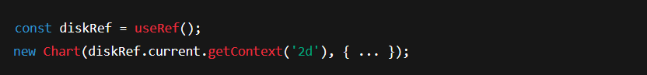
📊 B. Server Overview Module
Component Server overview()
Purpose: Display real-time-looking system metrics like Disk Usage, CPU Load, Memory Usage.
Libraries Used: Chart.js
Features:
Doughnut chart for Disk Usage
Line charts for CPU and Memory
UseRef Hook: Used to target canvas DOM elements for rendering charts.
Example:

Slide 34
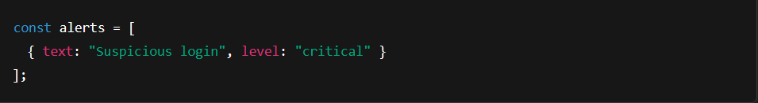
🛡️ C. Security Dashboard
Component: Security Overview()
Purpose: Display security alerts (e.g., login attempts, firewall updates).
Data: Rendered from a static array of alert objects.
Visual Indicators:
Red: Critical
Yellow: Warning
Green: Info
Code Logic:

Slide 35
🖥️ D. Workstation & Printer Dashboard
Component: Workstation Dashboard()
Purpose: Monitor system and printer statuses.
Data Format: Array of objects (each device with status, id,name)
UI: List view with real-time-like status badges (green/red)
Example:

Slide 36
👤 E. User Devices Module
Component: User Devices Dashboard()
Purpose: Show personal or assigned devices to users.
Similar Logic: Like the Workstation module but tailored to individual users.
🙏 F. Thank You Page
Component: Thank you()
Purpose: A simple feedback or logout thank you screen.
Features: CTA button, appreciation message
Good for: Branding and user trust

Slide 37
📁 4. Sidebar Navigation
Component:Sidebar()
Purpose: Handles navigation between modules.
Data Source: NAV_items array containing page IDs, labels, icons.
Logic: On click, sets the Page State
Code Example:

Slide 38
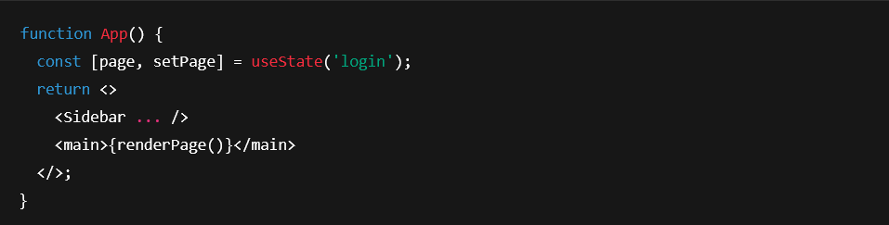
🎨 5. Styling & Responsiveness
Uses custom CSS with:
Dark UI theme
Box shadows & neon glow effects
Responsive layout via media queries
Sidebar collapses on small screens
Accessible markup using aria-label, role, etc
📦 6. Component Integration
The App() component handles page switching:

Slide 39
🔚 Summary Slide Suggestion
Title: ShivX Code Implementation Summary
Frontend: React + Chart.js
Architecture: Component-based SPA
Modules:
Login
Server Overview (Charts)
Security (Alerts)
Workstations & Printers
User Devices
Thank You Screen
Design: Responsive Dark Theme with Custom CSS
Data Handling: Static mock data for presentation/demo

Slide 40
✅ ShivX Application – Testing & Quality Assurance
🧪 1. Types of Testing Performed
Type of Testing | Description
Unit Testing | Verified individual components like Login, ServerOverview, etc., for correctness.
UI/UX Testing | Ensured the UI renders properly across different screen sizes and devices.
Functional Testing | Checked core functionalities like chart rendering, login form submission, and sidebar navigation.
Responsiveness Testing | Tested layout behavior on mobile, tablet, and desktop viewports.
Accessibility Testing | Verified semantic HTML, ARIA roles, color contrast for visually impaired users.

Slide 41
🔁 2. Manual Testing Workflow
Step | Action | Expected Result
1. | Load the dashboard in a browser | ShivX layout renders correctly
2. | Navigate between modules using sidebar | Correct page loads and highlights current selection
3. | Fill in login credentials and submit | Shows appropriate success or error message
4. | Hover on sidebar buttons | UI responds with glow effect
5. | Resize browser window | Layout adjusts for small screens
6. | Verify charts load | CPU, Memory & Disk charts render dynamically

Slide 42
🧰 3. Tools & Technologies Used for Testing
Tool | Purpose
Browser DevTools | Console errors, responsive design
Lighthouse | Accessibility, SEO & performance
React Developer Tools | Inspect component tree
Screen Readers (NVDA / ChromeVox) | Accessibility audit

Slide 43
🛡️ 4. Sample Test Cases (Manual)
Test Case | Input | Expected Output | Status
Login without email | Blank email field | “Please enter email and password.” | ✅
Navigate to Server Overview | Click sidebar item | Charts and metrics load | ✅
View on mobile screen | Resize to 375px | Sidebar collapses, layout adapts | ✅
Submit incomplete form | Password only | Error message displayed | ✅

Slide 44
🤖 5. Potential for Automated Testing (Future Scope)
To improve maintainability, ShivX could integrate:
Jest for unit testing components
React Testing Library to test interactions (e.g., form submission, button clicks)
Cypress or Playwright for end-to-end UI testing

Slide 45
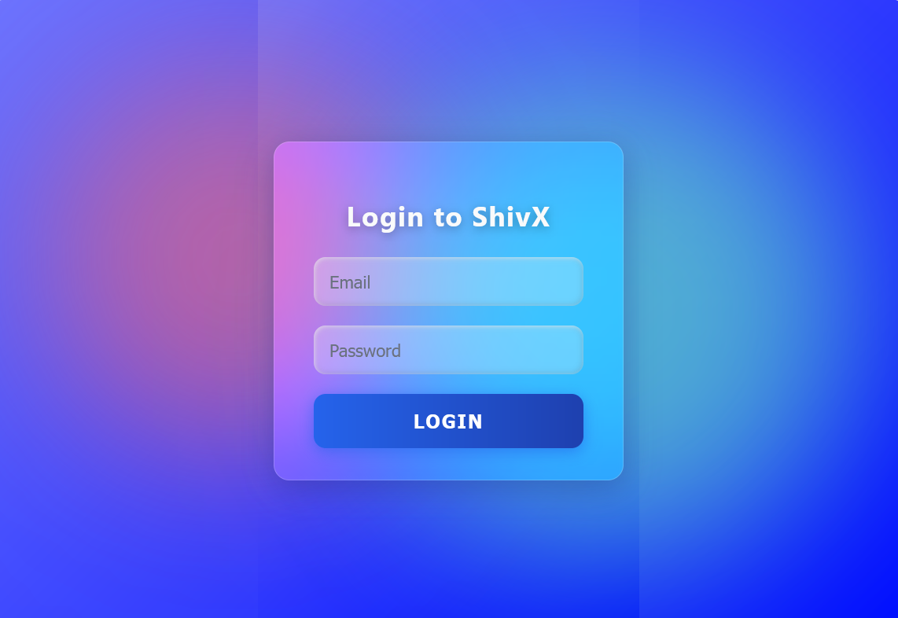

Slide 46
ShivX Dashboard Services Overview
Centralized Management: Easily create, configure, and monitor all your network devices—including servers, workstations, and printers—from a single, user-friendly dashboard.
24/7 Security Monitoring: Get real-time alerts, threat detection, and comprehensive security analytics to keep your infrastructure safe around the clock.
Remote Access: Securely access and manage your entire IT environment from anywhere, enabling flexible and efficient remote work.
Customizable Access Controls: Assign roles, manage permissions, and track user activity to ensure compliance and data integrity.
Scalable & Reliable: Effortlessly scale your network as your business grows, with guaranteed uptime and robust cloud infrastructure.
“Empower your enterprise with seamless, secure, and smart network management—anytime, anywhere”

Slide 47
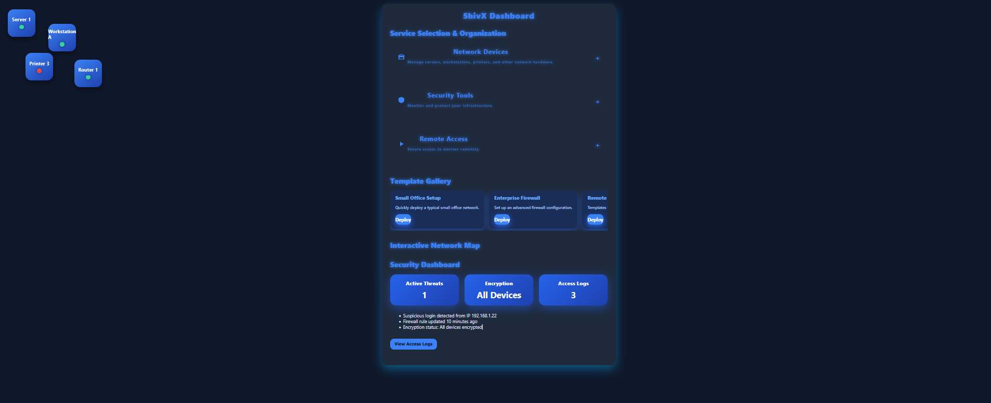

Slide 48
ShivX Network Dashboard Overview
Unified Network Visibility: Gain a real-time overview of all connected devices—servers, workstations, printers, and more—across your organization.
Interactive Topology Map: Visualize your entire network structure with easy-to-understand diagrams, showing device status and connectivity.
Performance Monitoring: Track bandwidth usage, device health, and network traffic patterns to optimize efficiency and prevent bottlenecks.
Instant Alerts: Receive notifications for connectivity issues, unusual activity, or device failures to ensure continuous uptime.
Simplified Device Management: Add, configure, or remove network devices with just a few clicks, all from one centralized dashboard.
“Empower your IT team with complete control and instant insights for a smarter, more reliable network”

Slide 49
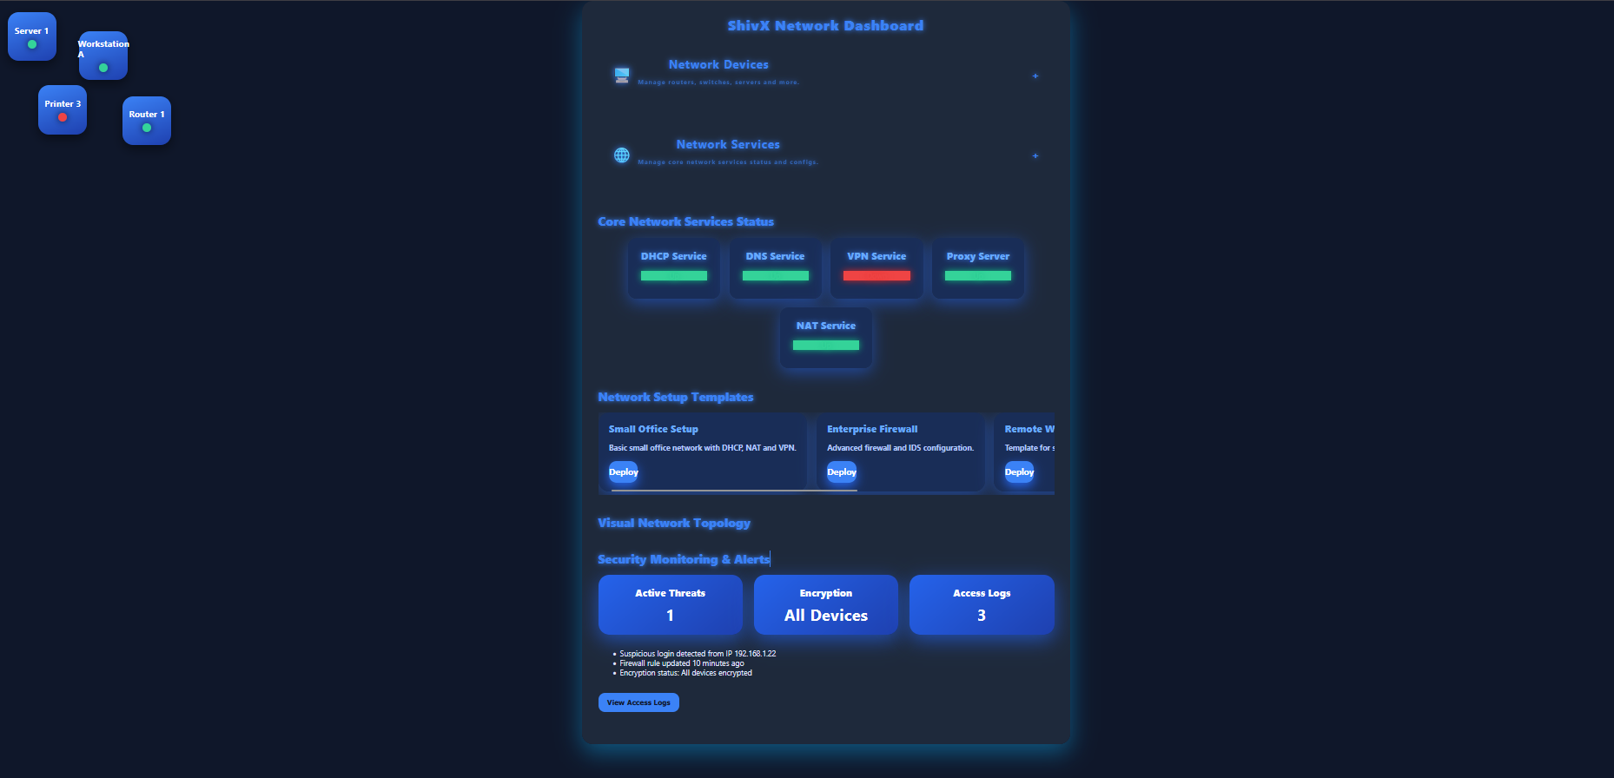

Slide 50
ShivX Security Dashboard
Real-Time Threat Monitoring: Continuously track potential security threats and vulnerabilities across your entire network infrastructure.
Comprehensive Alerts: Receive instant notifications on suspicious activities, unauthorized access attempts, and system anomalies.
Detailed Analytics: Access in-depth reports on firewall status, encryption health, and access logs to maintain full visibility.
Proactive Defense: Enable automated responses and quick mitigation to protect your network before issues escalate.
User Access Management: Monitor and control user permissions with audit trails to ensure compliance and secure operations.
“With ShivX Security Dashboard, safeguard your enterprise infrastructure with 24/7 intelligent monitoring and actionable insights”

Slide 51
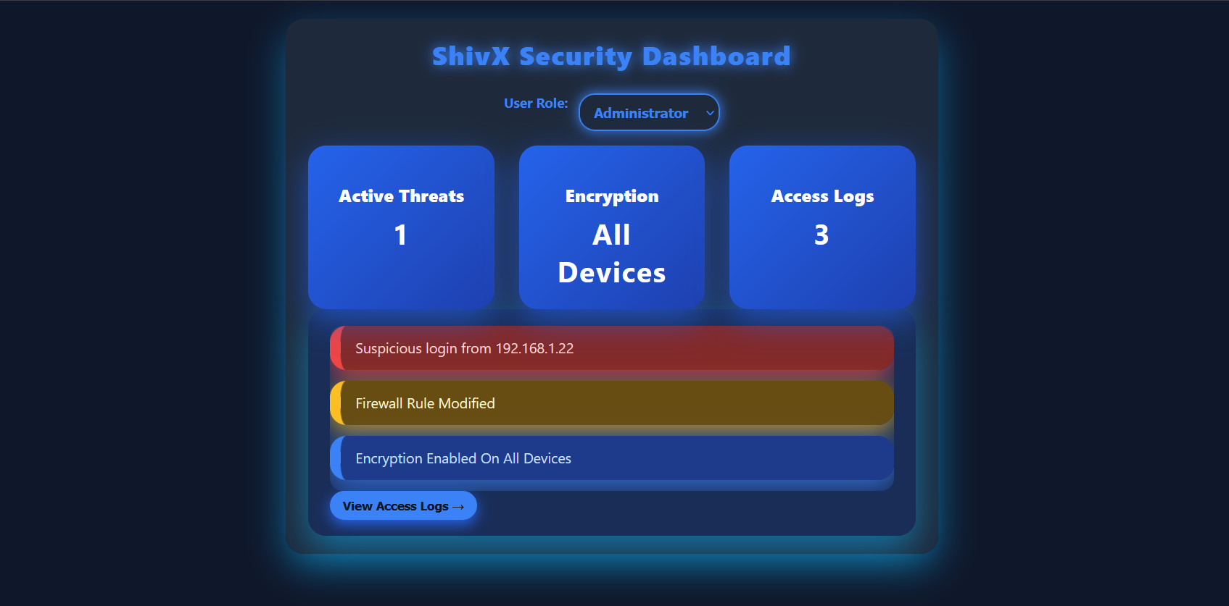

Slide 52
🔧 ShivX Infrastructure Dashboard – Overview
A sleek, real-time dashboard for monitoring server health, storage capacity, and hosted applications.
🔍 Storage Monitoring: Live disk usage, free space, and volume health with visual pie charts.
🧠 System Health: Real-time CPU load, memory usage, and I/O throughput with line graphs.
📦 App Management: Track hosted app status, uptime, and resource allocation.
⚠️ Smart Alerts: Green (healthy), Yellow (warning), Red (critical) indicators.
🖥️ Modern UI: Dark mode interface with neon highlights, sidebar navigation (Overview, Storage, Apps, Logs, Settings).
🔄 Auto-Refresh: Updates every 5 seconds for continuous visibility.

Slide 53
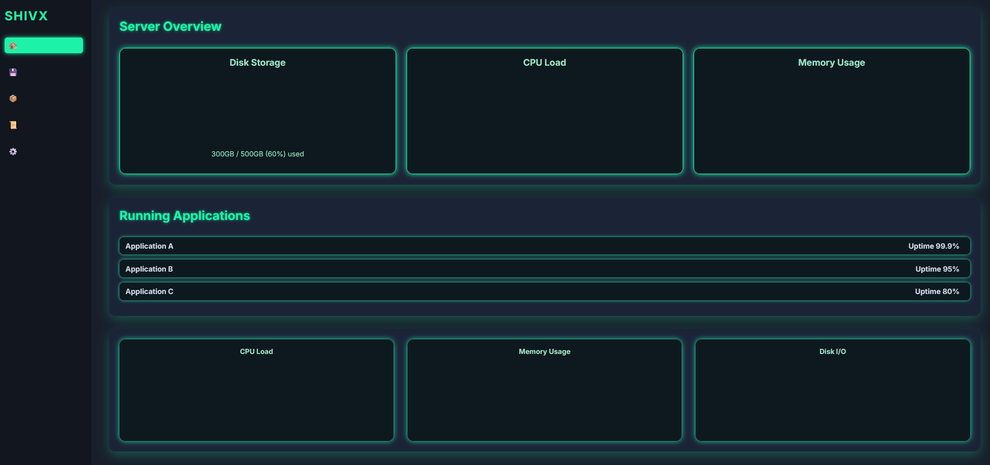

Slide 54
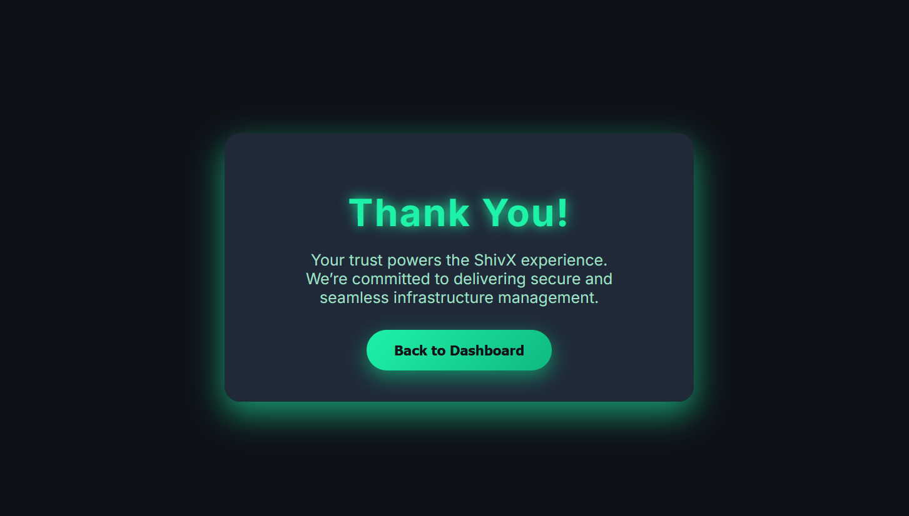

Slide 55
✅ Conclusion – ShivX Unified Dashboard
ShivX represents a modern, scalable, and visually engaging solution designed to simplify and centralize infrastructure monitoring. Built using ReactJS and Chart.js, it showcases real-time-like analytics, intuitive navigation, and a user-centric interface.
Through careful component-based architecture and responsive design, ShivX demonstrates the power of combining front-end technology with thoughtful UI/UX practices.
From server metrics to device monitoring and security dashboards, each module has been developed to be functional, accessible, and efficient.
This project not only strengthened my skills in front-end development, data visualization, and user interface design, but also deepened my understanding of building
production-ready applications with real-world usability in mind.
ShivX is more than just a project—it’s a demonstration of secure, smart, and seamless system management in a single unified view.

